Slide 1
Assessing performance Linear model performance

Slide 2
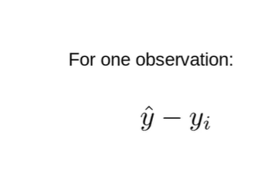
how do we know if our linear model is good or not well ???
there’s two metrics(system of measurement) that we can use and the
root mean squared error
To evaluate how the model is performing what you we do is take Y hat which is the value the computer is predicting and y which is thevalue that you're predicting for that particular observation and subtract them.
If value computer predicted is 12 and in reality it's 10 the difference is 2
so that's one observation

Slide 3
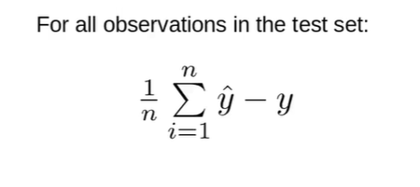
but I have in my test set many observations so for many observations what I would do is I would do the same thing Y hat minus y so I get the difference and then I average that distance right so I take the difference of all theobservations and I add them all up and I divide by the total number of observations and that gives me the average difference

Slide 4
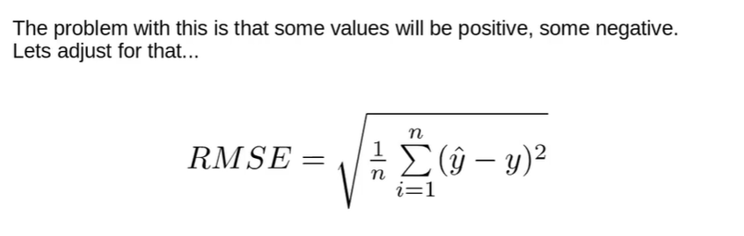
problem is that if we do this we're gonna have somewhere the computer value is over my predicted value and somewhere the computer value is under my predicted value so this means that I'll have some positives and some negatives and if I do that I'm gonna have the negatives and positives kind of valuesand it's not going to give me a really good understanding of how far away my model is from reality so the way I can compensate for that is I can take this and I can square it and so if I square that value and then take the average and then in the end I can take the square root of the value that gives me the root mean squared error so that's a pretty easy way to give you a metric (system of measurement) to know how close your model is to reality one

Slide 5
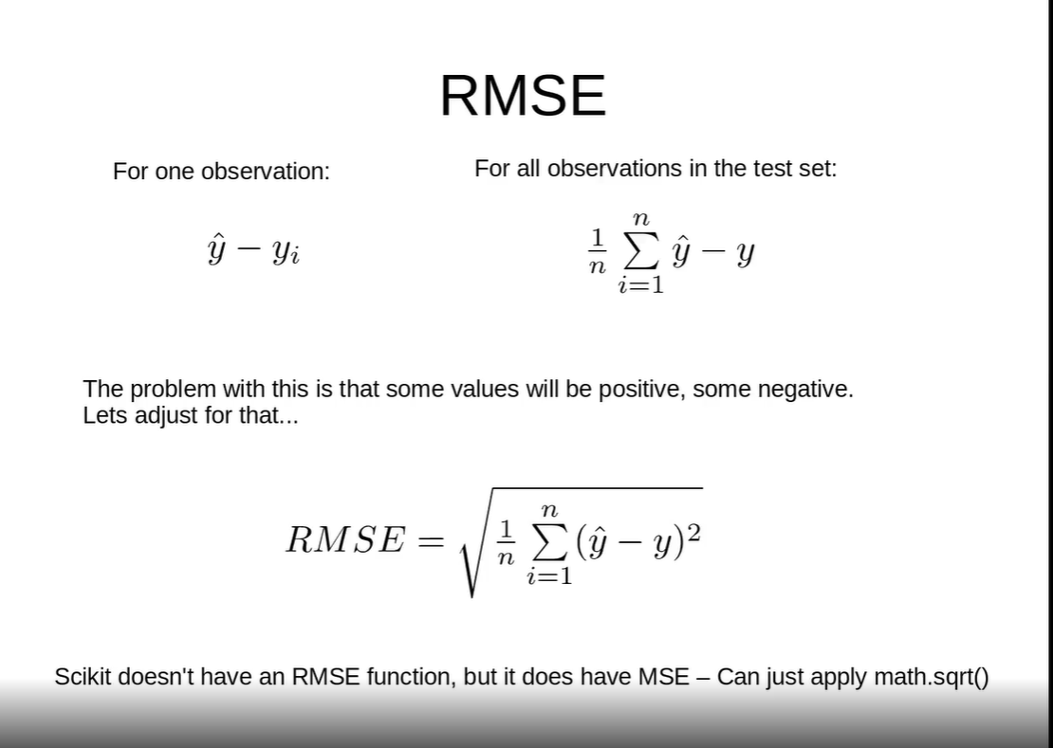

Slide 6
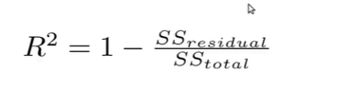
the other way that we can use to determine if our model is working well or not is called the
2. coefficient of determination R 2
R square is equal to one minus the squares of the residuals minus the sum of squares of the totals

Slide 7
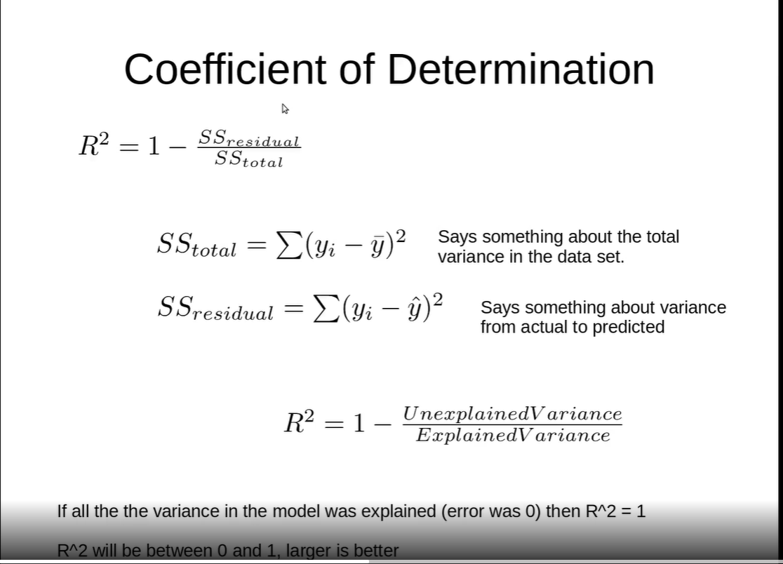

Slide 8
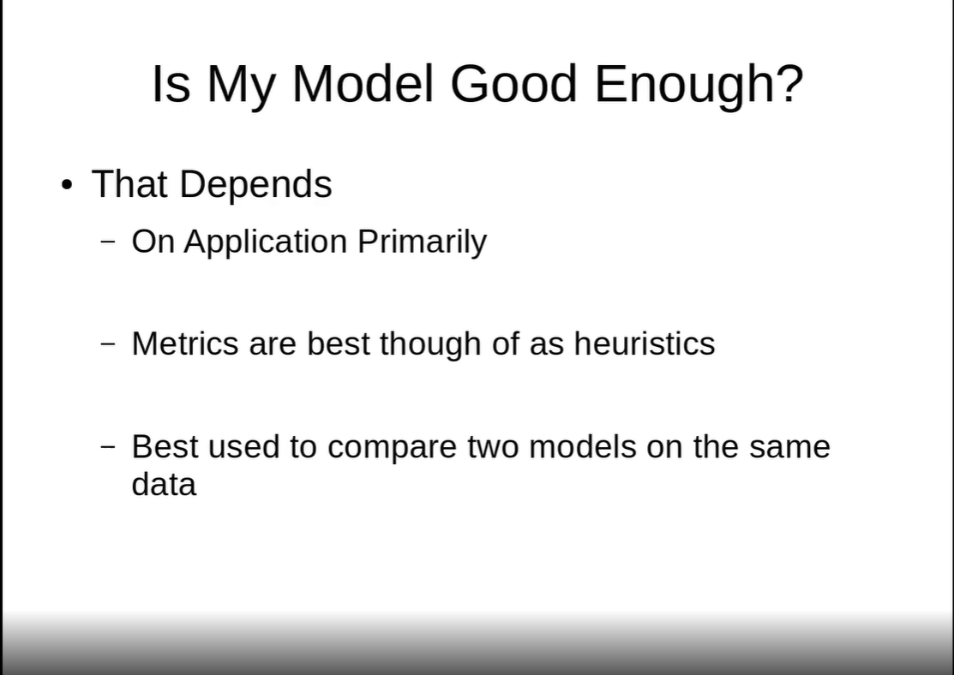

Slide 9
https://www.youtube.com/watch?v=dnlZyxlbkdY

Slide 10
as we all know observed values are the true values and the predicted values are those values which are predicted or returned by the model so we know that the lesser the difference between the observed and the predicted values the better is the model which has been f itted and if the difference between the observed and the predicted values is more it implies that the model fitting has not been so good

Slide 11
there are few measures or metrics which will reflect how good the model fitting has been done.
these are
1.the R square values and
2.The RMSC that is the root mean square error
Lets take an example of two vectors anobserved vector and a
projected vector and see how we can findout the goodness of fit .

Slide 12
for that we need a package known as the caret for which we will load library of caret .
we will create two sets of numbers one containing the observed values and one containing the predicted values and then we will find out how the motor performance can be measured

Slide 13
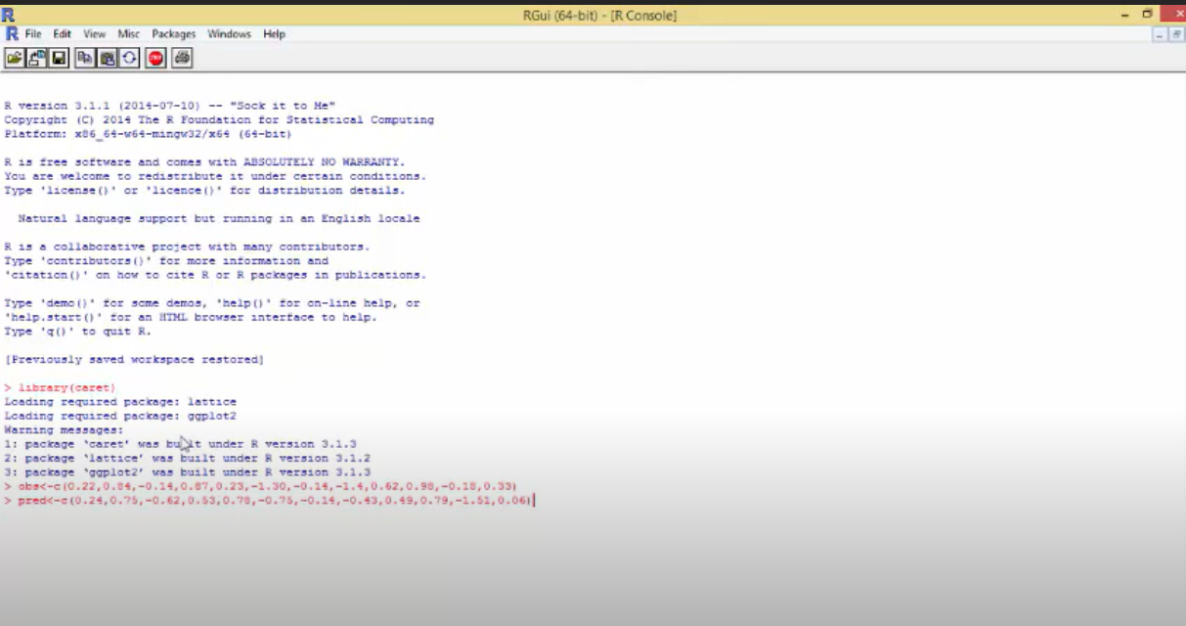

Slide 14
So lets take a set o f 12 numbers for the observed values and predicted values
the value of the residual will be equal to the observed values minus the predicted values .
we have a set of all the residuals and say we want to see a summarized version of the residual so we write summary
so when you see the minimum value, maximum value ,the mean, median and the quantiles we create a vector known as axis which will contain the extended values which will be later used for the purpose of plotting values.

Slide 15
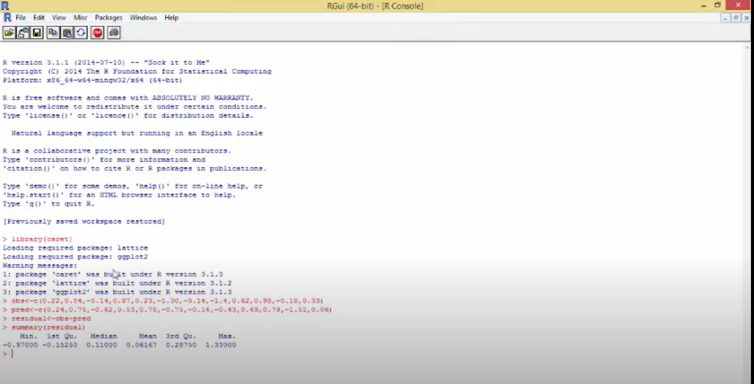

Slide 16
Below are the plots of the set of the observed values and a set of the predicted values. we see that they are distinct from each other on the note that if there is a 45 degree line ,the values do not lie exactly on that 45 degree line indicating the equivalence of the predicted and the observed values so for that we will plot that line in order to understand this better and so we fitted a 45 degree line ,whenever these circles these observations lie on that 45 degree line it means that observed values and the predicted values are the same that means those observations have been correctly predicted by the model so whatever the observed values were the model has also predicted them to be the same however whenever there is a deviation between the a point from this 45 degree line it means that the observed values and the predicted values are not the same that means the values predicted by the model are not the same as the observed value and there exists some error between them.

Slide 17
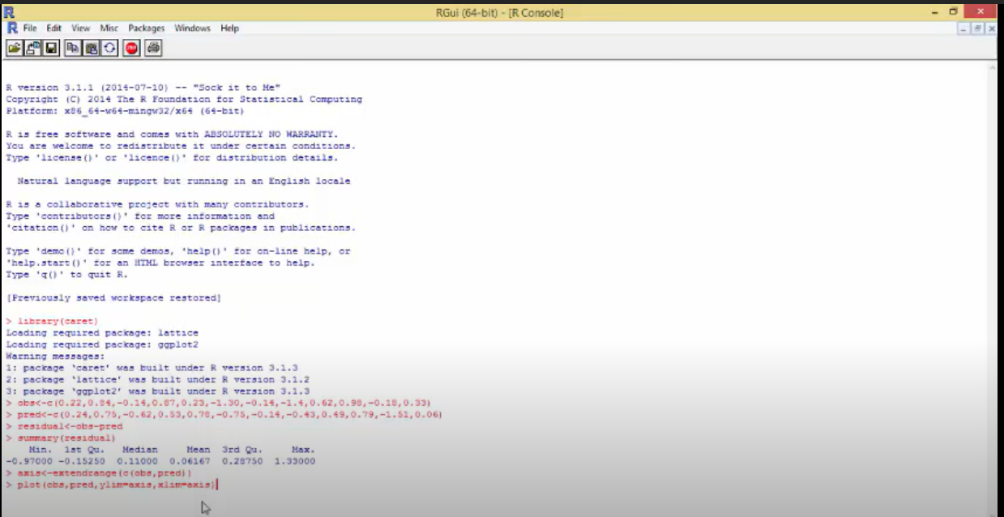

Slide 18
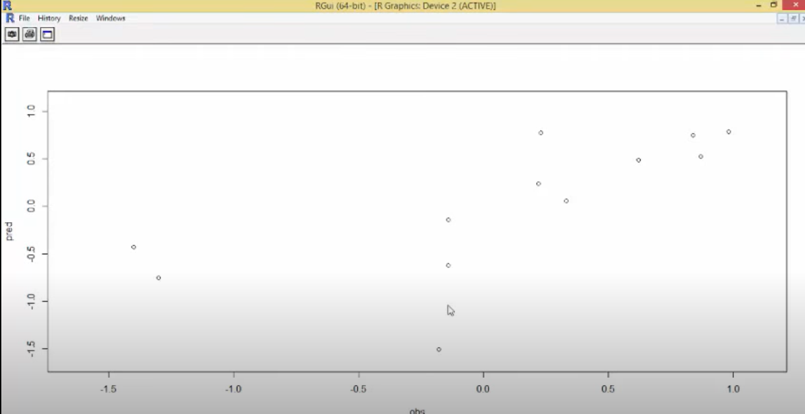

Slide 19
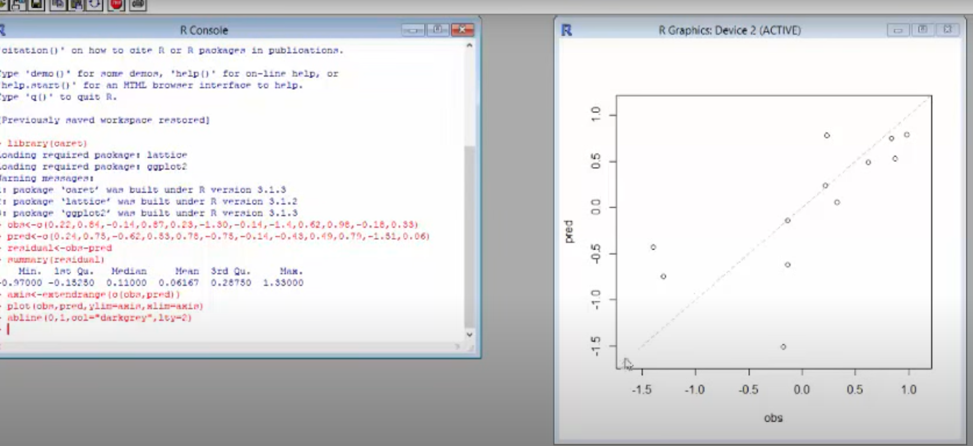

Slide 20
so to understand how the residuals are behaving we will plot the graph with the predicted values and the residuals which are generated so I plot predicted values and the residual and so this is another graph which shows how the predicted values and the residuals are behaving

Slide 21
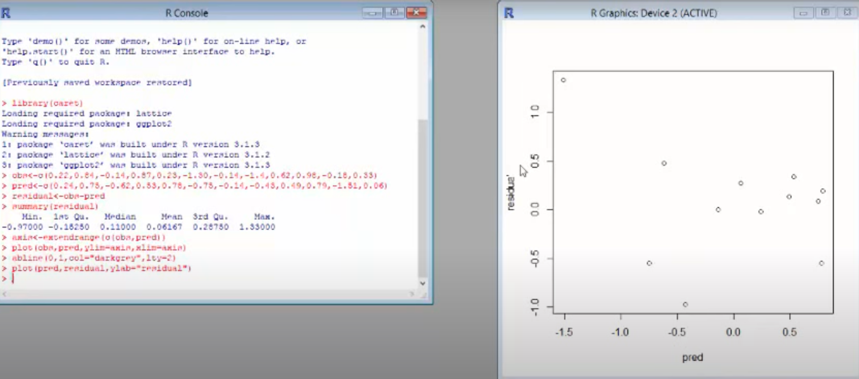

Slide 22
and then again to find out how the performance has been we'll draw a line to understand this, we see that the residuals are zero only for two observations so that means the observed valuesand the predicted values are the same in only two of these of the total number of observations sothere were a total of 12 observations out of them there are only two cases then observed values and the predicted values are the same implying that the residual value 0 other than that if you see these dots you can understand that somewhere the residuals are positive somewhere the residual is negative meaning that at times the predicted value is more than the observed value and at times the predicted value is less than the observed value that means there exists error in this model

Slide 23
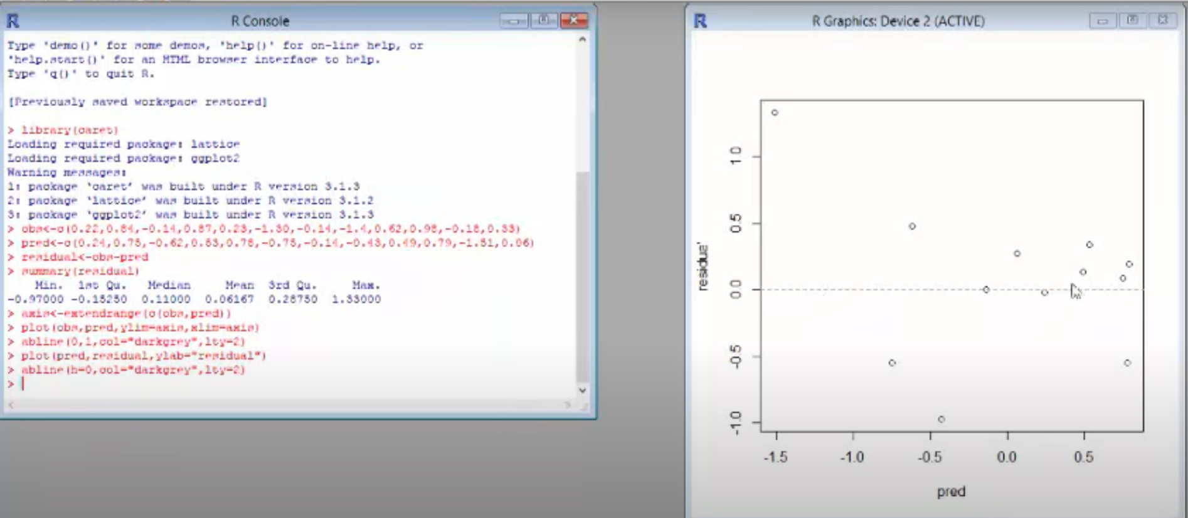

Slide 24
now I want to findout the rest the R square value which will tell me how good this fitting at the fitness has been so I write R square predicted and observed and this gives me a value of 0.49 which is equal to 49 percent so that means the model fit the goodness of fit measure is 49 percent that means 49 percent of the total variation in the model has been explained by P if those predicted values so it suggests that the model fit is not too good so it could have been more how to improve the model fitness

Slide 25
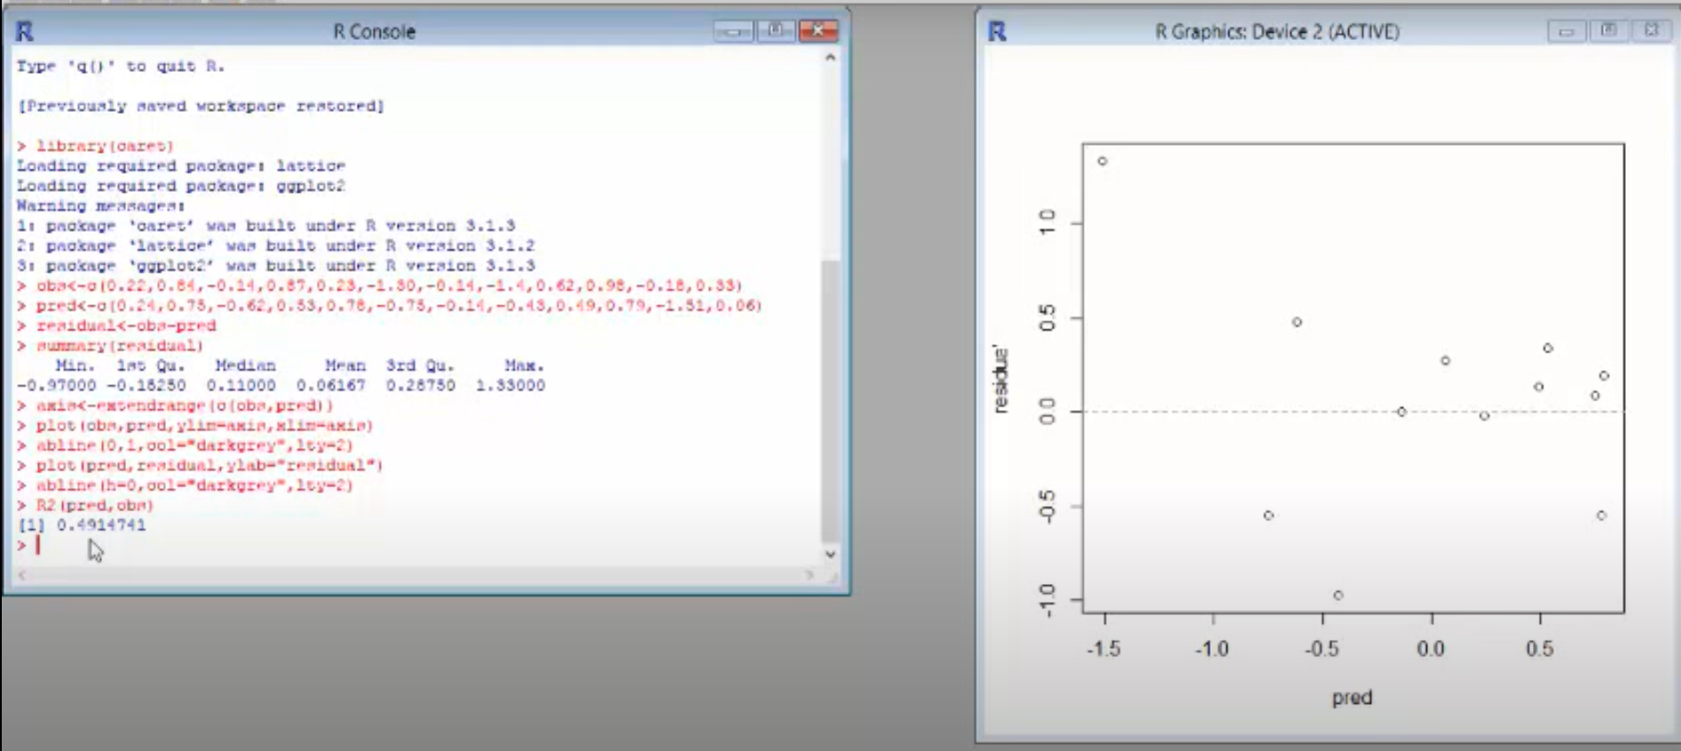

Slide 26
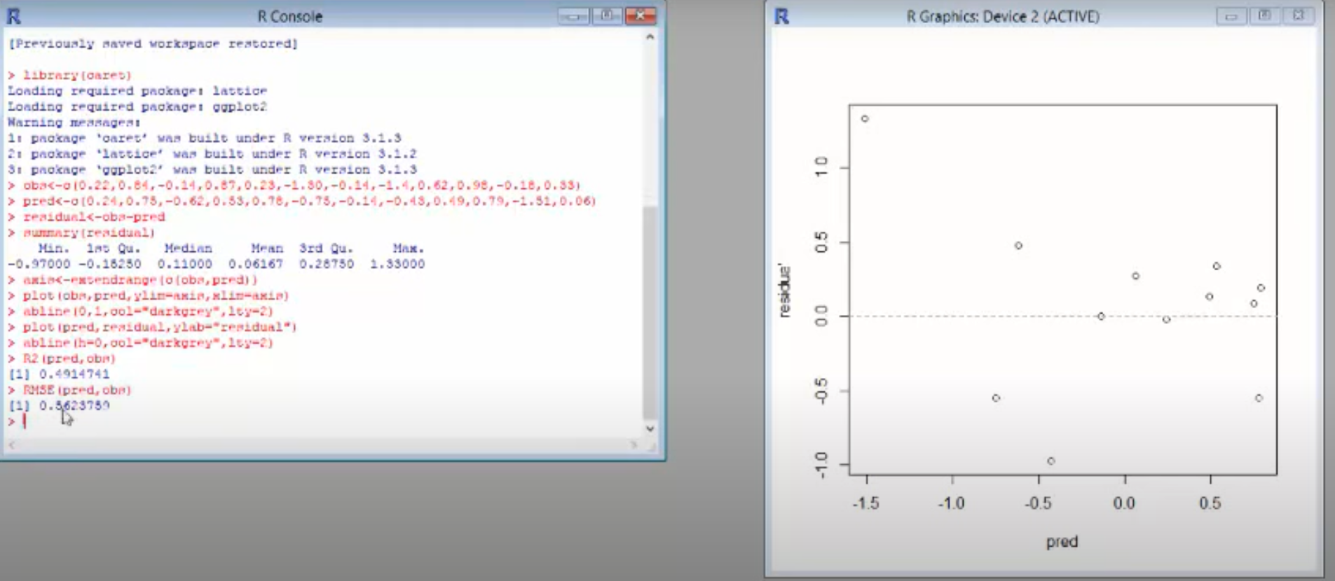

Slide 27
there is another metric which will help us to understand how goodness of fit or how performances measure the value
this metric is known as the RMS - the root mean square error
and we find that for observed and the predicted value and we see that the root mean square error is 56 .23
so the R square value should be as high as possible and the root mean square value should be as low as possible
the R square will basically indicate that what is the total variation which is being explained by a model so the higher the value of R square the better your model fitness is
which in our case we found out to be approximately 49% .
the root mean square error value is a measure of the square root of the average of the errors so you have your errors you square them up so that is why that's called the squared error.
the error is the difference between the observed and the predicted values you take the difference between them put a square take the summation and then have a square root of it so that gives me the root mean square values
so with this we find that the R square value and the root mean square value are two important metrics which will show that how goodness of fit is
there are more sophisticated methods to do but this is a preliminary analysis

